Slide 1
Chapter 07 Arrays (not ArrayLists for now)

Slide 2
Reasoning on using arrays

Slide 3
7
int weekDays = 7;
weekDays
Would you use this method to create variables for the 40000 Pitt students?

Slide 4
Coworker Presents
Student Presents
Give me the 2nd present from the Coworker array
Give me the 3rd present from the Student array

Slide 5
Creating 1D arrays

Slide 6
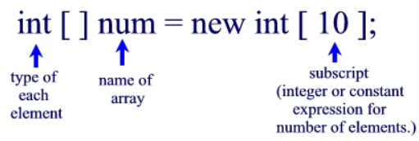
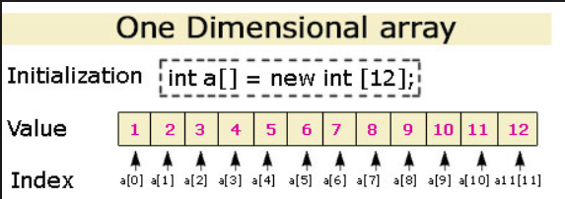
1D Arrays

Slide 7
If I could open that “box” labeled “a”, what would I see inside it? Will it have all the 12 integer values in it? (thing about the Elephant example)
The array “a” contains a reference of where the array is placed in memory (0x12)
a

Slide 8
int dozen = 12;
double [ ] sensorData = {4.1, 15.3, 7.7, 9.1};
double pi = 3.14;
String message = “This is a long string”;
int daysOfTheWeek =7;
char letter = ‘A’;
 |  | A | B | C | D | E | F | G | H | I
1 |  | 12 | 0x3B | 3.14 | 0x3F | 7 | A | 13 | 2 | T
2 |  | 11.2 | 53.1 | 2 | 4 | 9 | a | W | z | 6
3 |  | 14 | 4.1 | 15.3 | 7.7 | 9.1 | T | h | i | s
4 |  | “ “ | i | s | “ “ | a | “ “ | l | o | n
5 |  | g | ” “ | s | t | r | i | n | g
6
7
8

Slide 9
2D Arrays

Slide 10
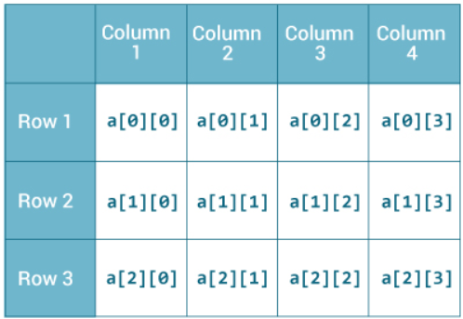
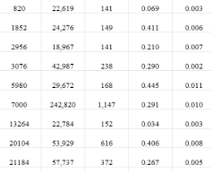
2D Arrays (tables)
double [ ][ ] a = new double[3][4];

Slide 11
3D Arrays

Slide 12
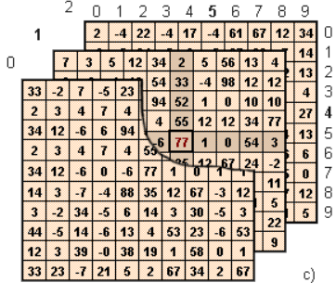
3D Arrays – Arrays of Tables
double [ ][ ][ ] yearExpenses = new double[month][day][expenseType];
April
March
February
January
13th
14th
15th
Gas
Food
Bus

Slide 13
4D Arrays and beyond

Slide 14
5 year expense data for IRS
double [ ][ ][ ][ ] fiveYearsExpenses = new double[year][month][day][item];
20013
20014
20015
20016
20017

Slide 15
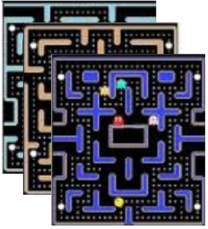
4D Arrays and beyond
double [ ][ ][ ][ ] game = new double[gameLevel][gameNumber][row][col];
Beginner's Level
Intermediate's Level
Expert's Level

Slide 16
How do I work with a portion of that data?
Let’s say: only the data from January 2016?

Slide 17
Slicing (N)D arrays into (N-1)D arrays

Slide 18
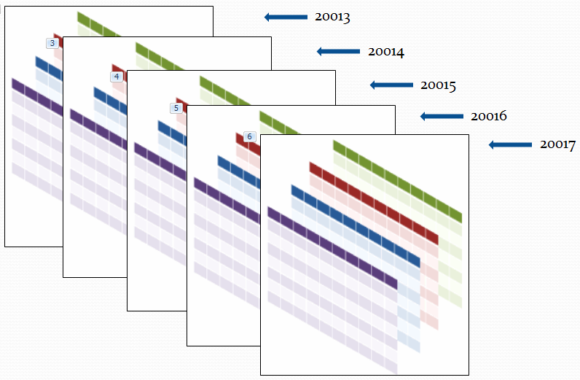
Slicing ND arrays into (N-1)D arrays
double [ ][ ][ ][ ] fiveYearExpenses = new double[5][12][31][4]; // a 4D array
double [ ][ ][ ] year2016Expenses = fiveYearExpenses[3]; // a 3D array
double [ ][ ] july2016Expenses= year2016Expenses[6]; // a 2D array!
double [ ] expensesOnThe5ThDay = july2016Expenses[4]; // a 1D array
double gasExpenseOnThe5ThDay = expensesOnThe5ThDay[0]; // a number

Slide 19
double [ ][ ][ ][ ] game = new double[gameLevel][gameNumber][row][col];
double [ ][ ][ ] mazesForBeginners = game[0];
double [ ][ ] secondMazeForBeginners = mazesForBeginners [1];

Slide 20
Copying Arrays

Slide 21
Copying an array into another array
int[] arrayA = { 1, 2, 3, 4};
System.out.println(arrayA);
int[] arrayB = arrayA;
System.out.println(arrayB);
arrayB[1] = -1;
System.out.println(arrayB);
System.out.println(arrayA);
Located at 0x3B memory position
1, 2, 3, 4
arrayB located at 0x6A
1, 2, 3, 4
1, -1, 3, 4
1, -1, 3, 4
 |  | A | B | C | D | E | F | G | H | I
1 |  | 12 | 0x3B | 3.14 | 0x3F | 7 | A | 13 | 2 | T
2 |  | 11.2 | 53.1 | 2 | 4 | 9 | a | W | z | 6
3 |  | 14 | 1 | 2 | 3 | 4 | T | h | i | s
4 |  | “ “ | i | s | “ “ | a | “ “ | l | o | n
5 |  | g | ” “ | s | t | r | i | n | g
6 |  | 0x3B
7
8
ArrayB

Slide 22
Copying/Cloning an array
 |  | A | B | C | D | E | F | G | H | I
1 |  | 12 | 0x3B | 3.14 | 0x3F | 7 | A | 13 | 2 | T
2 |  | 11.2 | 53.1 | 2 | 4 | 9 | a | W | z | 6
3 |  | 14 | 1 | 2 | 3 | 4 | T | h | i | s
4 |  | “ “ | i | s | “ “ | a | “ “ | l | o | n
5 |  | g | ” “ | s | t | r | i | n | g
6 |  | 0x7B
7 |  |  | 1 | 2 | 3 | 4
8
int[] arrayB = new int[arrayA.size]; // arrayB is a new array
// with same size of arrayA
We can copy the contents of arrayA into arrayB with a FOR loop later
Changing any value of arrayB will NOT change the contents of arrayA

Slide 23
Adding more numbers to an existing Array

Slide 24
Increasing array size
 |  | A | B | C | D | E | F | G | H | I
1 |  | 12 | 0x3B | 3.14 | 0x3F | 7 | A | 13 | 2 | T
2 |  | 11.2 | 53.1 | 2 | 4 | 9 | a | W | z | 6
3 |  | 14 | 1 | 2 | 3 | 4 | T | h | i | s
4 |  | “ “ | i | s | “ “ | a | “ “ | l | o | n
5 |  | g | ” “ | s | t | r | i | n | g
6 |  | 0x7B
7 |  |  | 1 | 2 | 3 | 4 | 9 | 15 | 11
8
Can we extend arrayA few bites more?
0x7B
int[] arrayB = new int[arrayA.length + 3]; // arrayB is a new array
for(…) copy the contents from A to B
Add the new values to B
arrayA = arrayB; // put the new reference in arrayA

